Slide 1
INTERNSHIP STUDIO
TRAINING: ETHICAL HACKING
CANDIDATE NAME: ROHIT GHAWALE

Slide 2
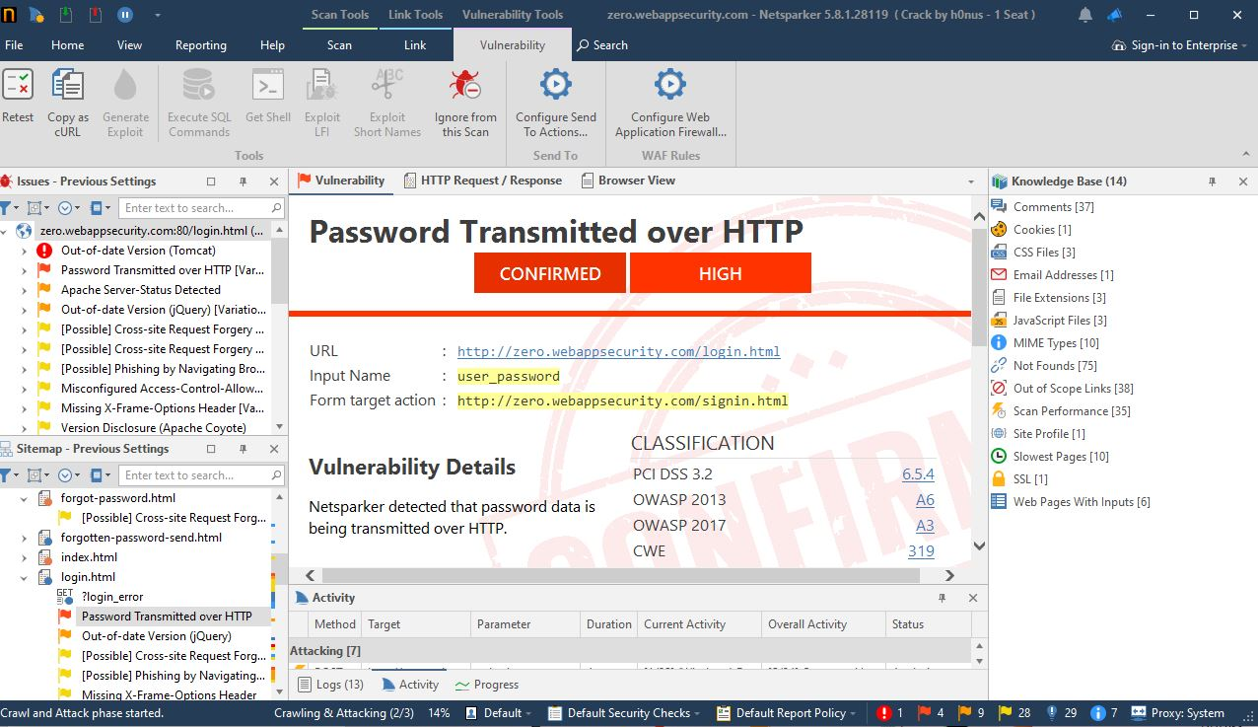
Below screenshot shows the vulnerability existed in our scanned site. Password is transmitted over an insecure bridge or network so someone can easily steal confidential information.

Slide 3
Report writing for given situation:
VULNERABILITY REPORT :-
http is less secure method for data transfer between server and site as it is not a well secure method to use anyone with enough experience may steal the data package while transmission is taking place. This will be responsible for breaches in password or sometime other confidential information.
In order to deal with this type of attack we can use a more secure method for transmitting the data which is known as https. This method is way more secure that standard http connection.
HTTP: hyper text transfer protocol
HTTPS: secure hyper text transfer protocol

Slide 4
threats:
As the data is transmitting over an insecure bridge anyone may some basics of penetration on the network and steal valuable information( like password ) and other stuff.
Method’s to deal with these type of threat :
All the data (i.e. user credentials , username and passwords) must all be served over an HTTPS network protocol, it is a secure method of network and all data transferred over this network is safe from any attacker or threats.

Slide 5
Location of threat detected:
URL :http://zero.webappsecurity.com/login.html
Input Name :user_password
Form target action :http://zero.webappsecurity.com/signin.html
Method to detect the threat:
It was detected by an well known automatic vulnerability application known as NETSPARKER

